Slide 1
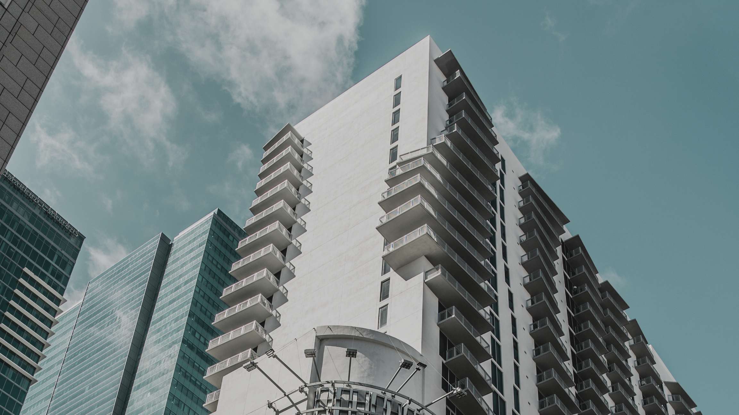


PREDICTING THE STATUS OF THE INTERVIEW
PRESENTING BY Harikrishna K

Slide 2


TABLE OF CONTENTS
Problem Overview
Data Description
Overall Solution Approach
Key Findings
Model Comparision

Slide 3
PROBLEM OVERVIEW
As i am a Data Scientist of one of the big MNC, where my company usually hires more than 10k candidates every year. To do this hiring process they conduct more than 1 lakhs of interviews every year.
So my team cameup with One of the Modern Technology called Interview-Intel, This is the modern way to approaching the hiring process by considering all the aspects of the
interview process
An Interview-Intel is the interview intelligence tool which records, transcribes, and analyzes candidate conversations. It helps the hiring managers, recruiters, and HR Business Partners (HRBPs) to gain deeper visibility into the interview process
As i am the Data Scientist I want to predict the status of the interviews so that recruiters can check the sanity of the interview and find if the interview was biased

Slide 4



Data Description
Here we have 27 features. In which we have 20 continues values and 7 categorical variables
Numerical
Categorical
Interview ID
Profile
Candidate ID
Columns
Categorical
Perceived Emotion Interviewer
Interviewer ID
S.L.R.C
S.L.R.I
N.I.C
Perceived Emotion Candidate
A.T.T
N.I.I
Interview Intro
L.M.I
S.P.I
Target
Numerical
Candidate Intro
L.M.C
S.P.C
Opp to ask
S.R
L.A.C
L.J.T.C
L.A.I
C.R
L.J.T.I
Q.A
Interview duration

Slide 5

Target Variable
It is a Multi Class Classification Problem, Where the Status Consist of 3 levels,
Consider, May Consider, Not Consider
All the 3 levels has the Same proportion of data, So need not to perform any samplig technique
Not Consider
27.5%
Consider
39.9%
Training data info
5800 rows &
27 Columns
Testing data
info
1200 rows &
26 Columns
May Consider
32.6%

Slide 6
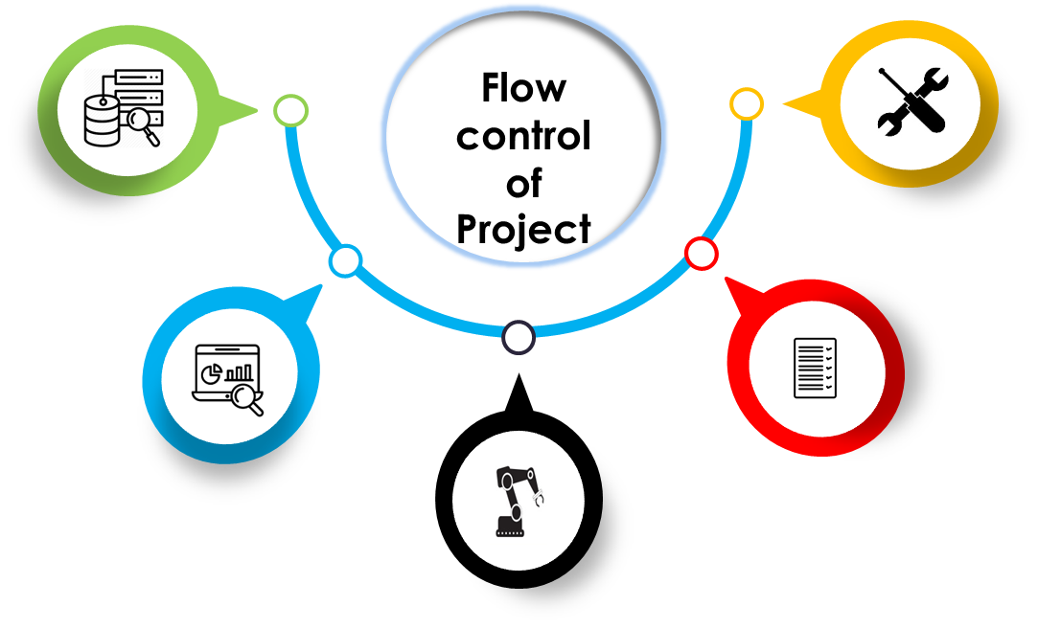
Requirement Analysis
Data is collected from
Interview Intel Tool.
Enhancing performance
The performance of model is improved by again refining the data and building the model again.
Exploratory Data Analysis
The dataset is being investigated to discover hidden patterns
Performance
Testing
After creating the model the performance of model is being tested by using unknown data.
The performance is analyzed using accuracy score because the data was balanced.
Classifier
The datasets are trained
and Model is created.

Slide 7
DATA PREPROCESSING
Data preprocessing is the process of transforming raw data into a useful, understandable format.
Performing OHE
Missing values Treatment
Standard Scaling
Converting the Categorical variabe
to numerical variable by applying get dummies
There are only few data which has missing values so
I have imputed categorical variable by using mode and continious variable by using median
The Features where having different range so to make the data in to same range
I have performed standard scaler because the data were normaly distributed
Where machine learning algorithm can understand, which in turn improve predictions as well as classification accuracy of a model.

Slide 8

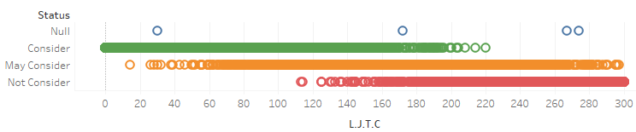

Key Findings
The Candidate who have Joined Late to Interview are having the higest chances of Not Considering
They have asked minimum 2 Questions and Maximum 7 Questions in the Interview
Speak to Listen Ratio Candidate and Speak to Listen Ratio Interviewer are highly correlated so we can keep any one feature
The Interview Id and Candidate Id are unique so we can drop them it is not impacting much for the prediction
Only Late Joining Time Candidate [L.J.T.C] is contributing More than 50% of information
By selecting Importating Features based on RandomForest we got 5 Features which are contributing more to predict the status [Those are 'L.M.C', 'L.J.T.C', 'N.I.C', 'S.P.C', 'Interview duration] these 5 features are giving you more than 95% of model accuracy

Slide 9


100
75
MODEL COMPARISION
50
25
By comparing with all the Algorithm SVM[Support Vector Machine] (Linear)
is giving you the higest accuracy
0
KNN
Random Forest
SVM (Linear)
Logistic Regression

Slide 10




THANK YOU
PERSONAL INFO
Name : Harikrishna K
#72, 4th main, 11th cross Bapujinagar, Bangalore 560026
+91 8247682383
hariisname@gmail.com
I look forward to working with you

